Slide 1

Smart Letter Box
IoT Project
Group Members
Usama Azhar
Ayesha Ali
Abdul Wahab

Slide 2
Table of Content
Smart Letter Box
Conceptual Design
Features of the Project
Software Flow
Hardware Requirements
Task Distribution and Timeline of Project

Slide 3
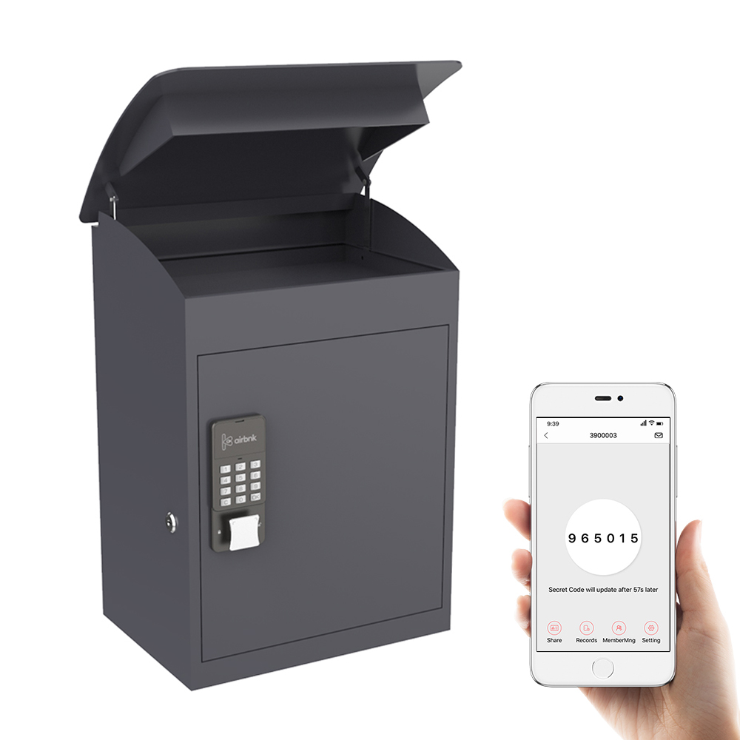
Smart letter box
Smart letter box is a secure letter box with
user feedback and control via server.
It provides secure and real time tracking
of the parcel.
Can be monitored on users app and
companies' main server.

Slide 4
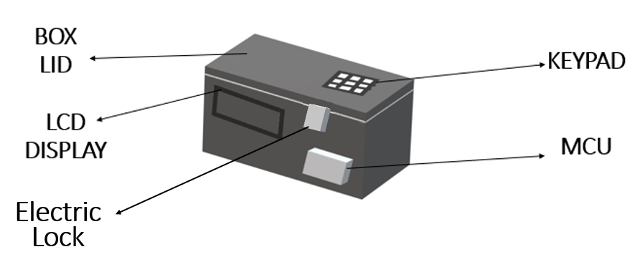
Conceptual design

Slide 5
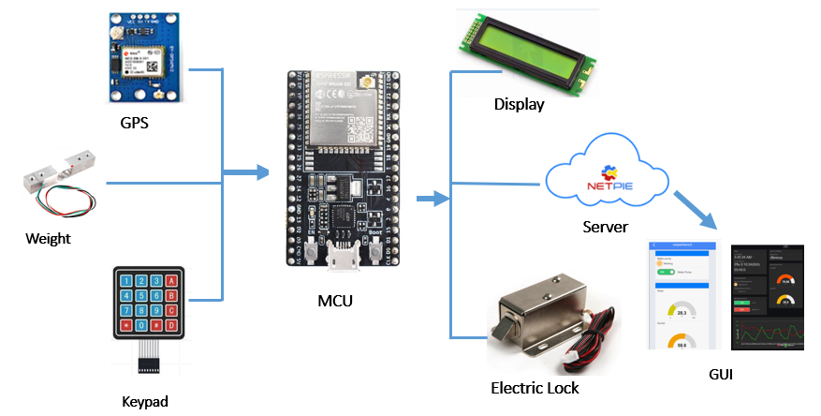
Conceptual design

Slide 6
Features (1/4)
The key features of the project includes
Internet Connectivity (Wi-Fi/GSM)
Location (GPS)
Display and Keypad
Electric Lock (Password Protected)
Weight
Battery Powered

Slide 7
Features (2/4)
Connectivity
Prefer Wi-Fi connection when available.
GSM (3G) connection during transit and unviability of Wi-Fi.
Data transfer to cloud server after every x-time interval.
Location
GPS location for tracking.
Latitude and longitude data.
Update in server if changed

Slide 8
Features (3/4)
Weight
Calibrated Load Cells inside box to measure parcel weight.
Weight data to cloud server and display.
Warning if exceeds max weight limit.
Lock
Electric lock operated using MCU controlled switches.
Password implementation in software algorithm.
Update server regarding lock status.

Slide 9
Features (4/4)
Display and Keypad
LCD display for user instruction.
Weight, location and status information on Display.
Hex keypad for password and user input.

Slide 10
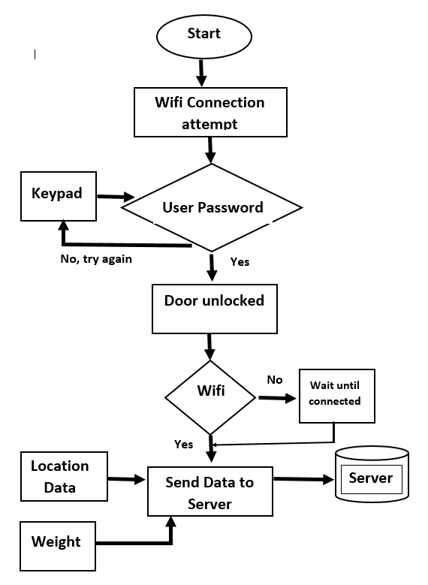
Software Flow

Slide 11
Hardware
The main hardware components used in project are
MCU: ESP32
Location (GPS): GPS Module NEO 6M
Connectivity: ESP32 built-in Wi-Fi & GSM Module SIM800L
Display: 16*2 LCD
Keypad: Hex Keypad
Electric Lock: Servo Motor
Weight: Half Bridge Load HX711

Slide 12
Task distribution
Ayesha Ali
Internet Connectivity (Wi-Fi/GSM) {SW A1.1}
Display {SW A1.2}
Hardware Configuration: ESP32, SIM800L and LCD 16*2 {HW A1.1}
Usama Azhar
Location (GPS) {SW B1.1}
NETPIE Server & GUI {SW B1.2}
Hardware Configuration: ESP32 & GPS Module NEO 6M {HW B1.1}
Abdul Wahab
Keypad {SW C1.1}
Electric Lock (Password Protected) {SW C1.2}
Weight {SW C1.3}
Hardware Configuration: ESP32, Hex Keypad & Half Bridge Load Cell HX711 {HW C1.1}

Slide 13
Task distribution w.r.t. timeline
 | Week 1 | Week 2 | Week 3 | Week 4 | Week 5 | Week 6 | Week 7 | Week 8
HW A1.1
SW A1.1 Internet Connectivity
SW A1.2 Display
HW B1.1
SW B1.1 Location
SW B1.2 Server
HW C1.1
SW C1.1 Keypad
SW C1.2 Lock
SW C1.3 Weight

Slide 14
Thank YOU!

